Slide 1
Logistic regression with L1 regularization
Group 14 batch A
Nandini - 30, Subashree - 48,
Mahi Vignesh -56, Lakshman- 67

Slide 2
Applications
1. Customer Churn Prediction
2. Credit card fraud prediction
3. Spam mail prediction
4. Diabetes prediction

Slide 3
Customer Churn Prediction
Customer churn prediction is pivotal for businesses seeking to maintain their customer base.
Churn, in this context, denotes the discontinuation of a service or product by customers.
To address customer retention challenges, the Customer Churn Prediction subtopic utilizes logistic regression with L1 regularization.
The focus of the approach is on predicting customer churn while emphasizing feature selection through L1 regularization.
The objective is to discern critical factors influencing customer attrition, offering valuable insights for businesses to implement effective retention strategies.

Slide 4
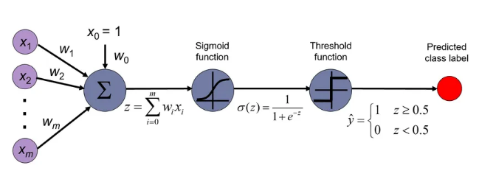
Logistic regression

Slide 5
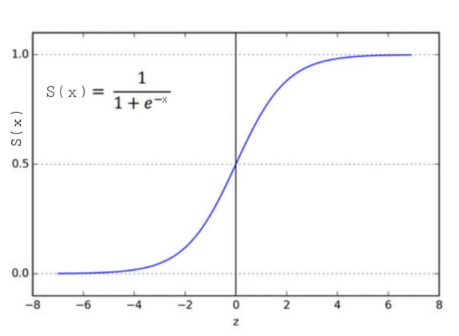
Sigmoid function

Slide 6
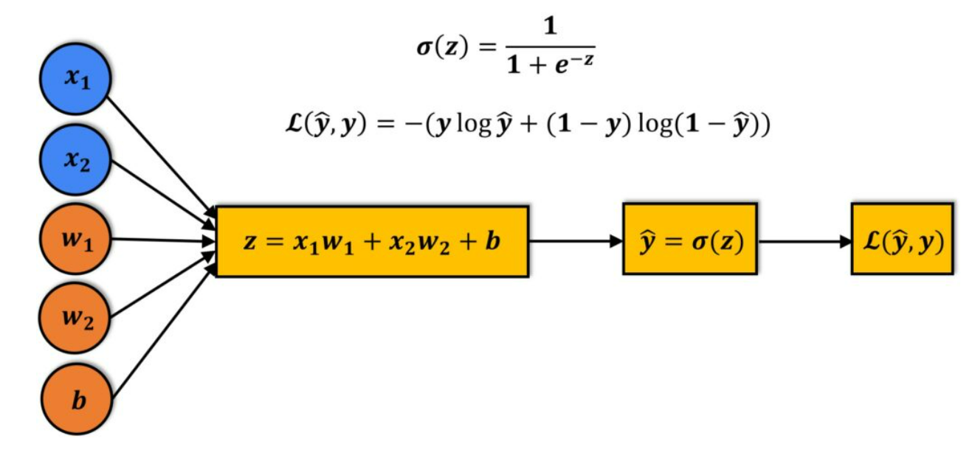

Cost function

Slide 7
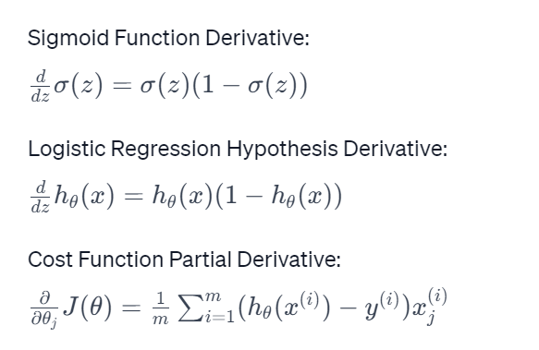

Slide 8
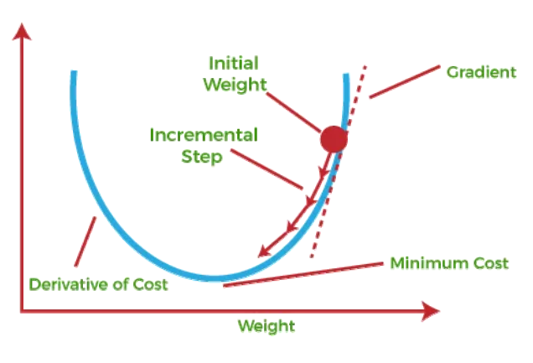
Gradient descent

Slide 9
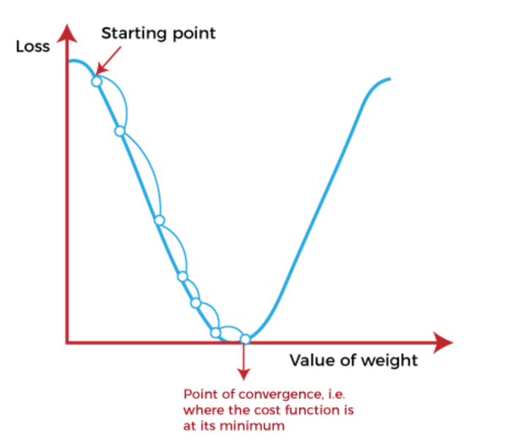
Gradient descent

Slide 10
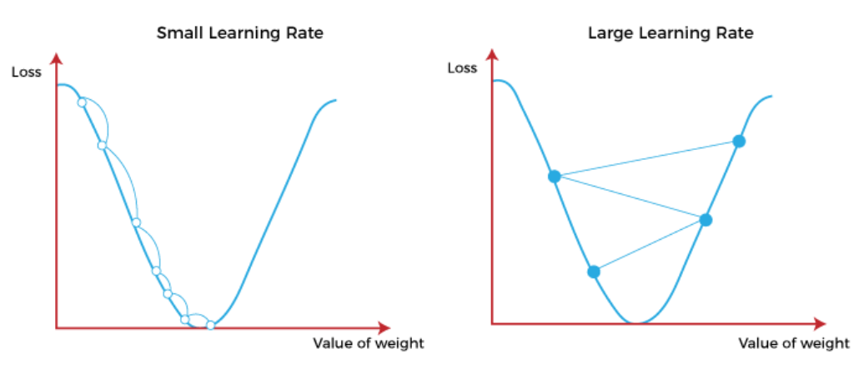
Gradient descent

Slide 11
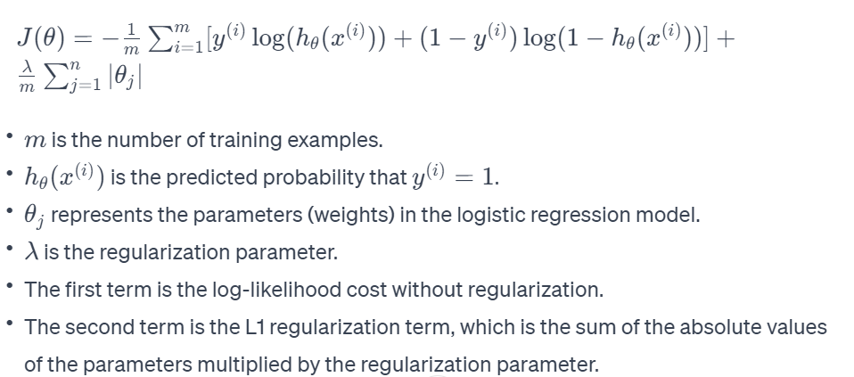
L1 regularization

Slide 12
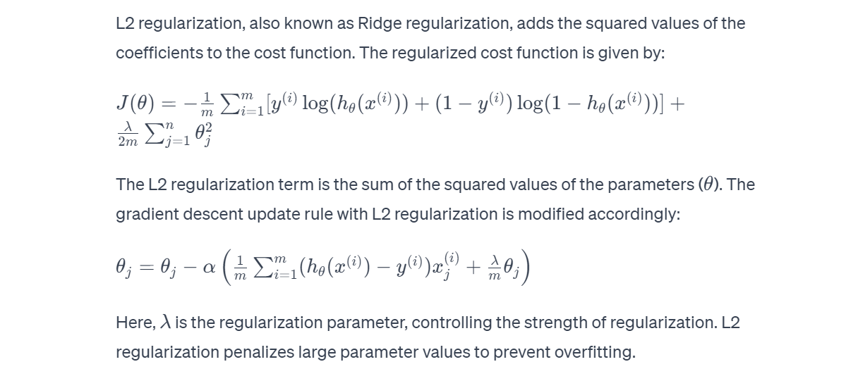
L2 regularization

Slide 13
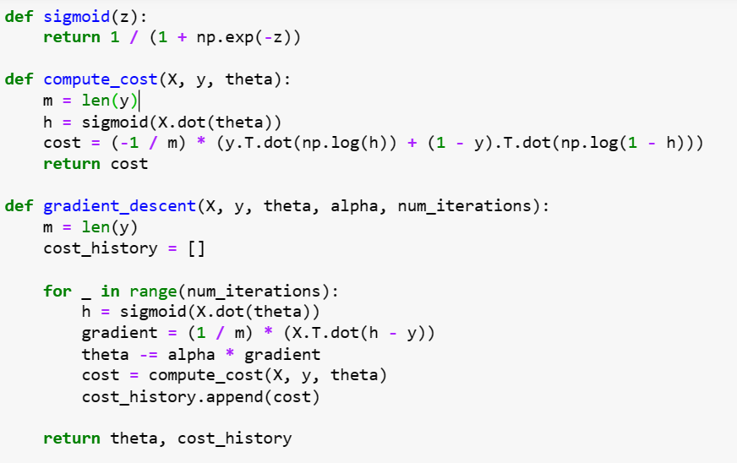
Logistic regression

Slide 14
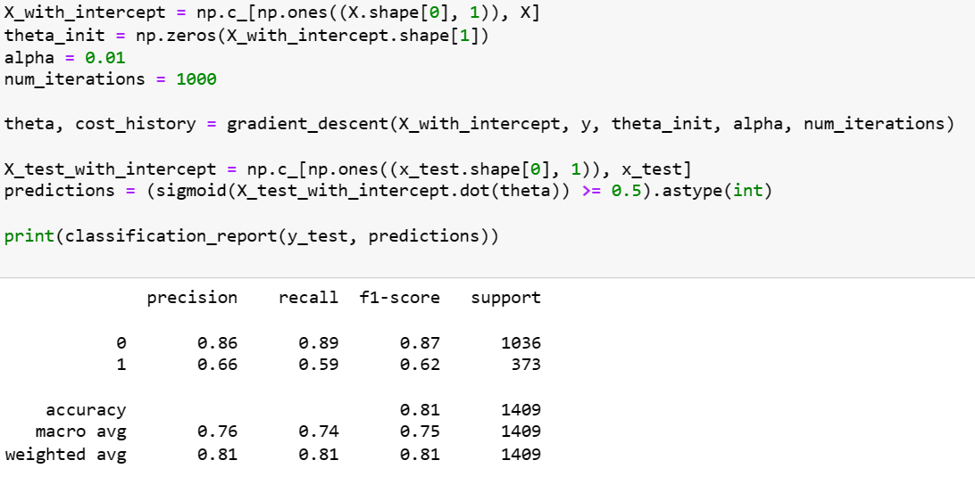
Logistic regression

Slide 15
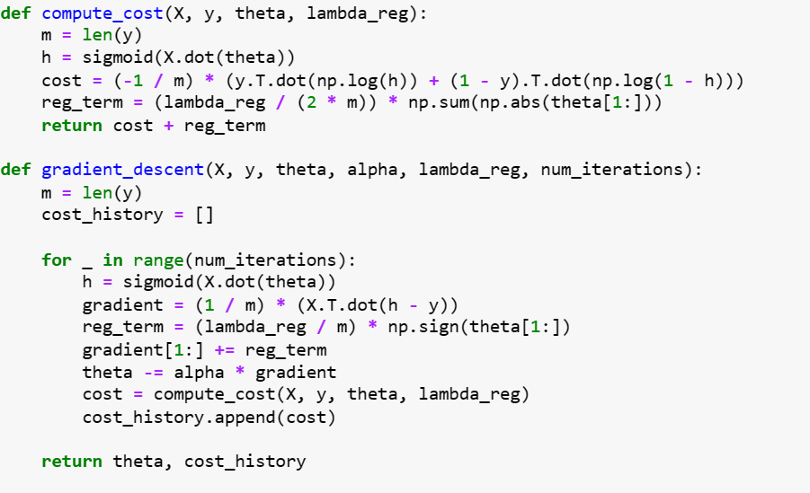
Logistic regression with L1

Slide 16
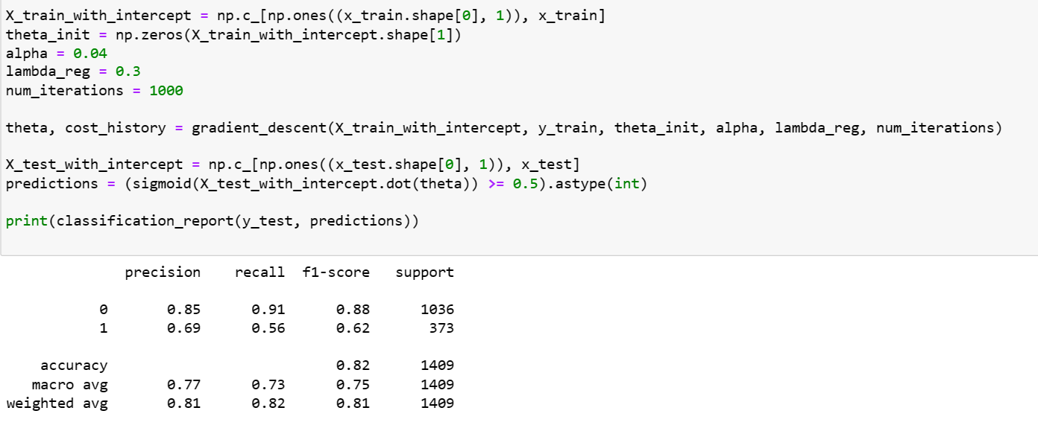
Logistic regression with L1

Slide 17
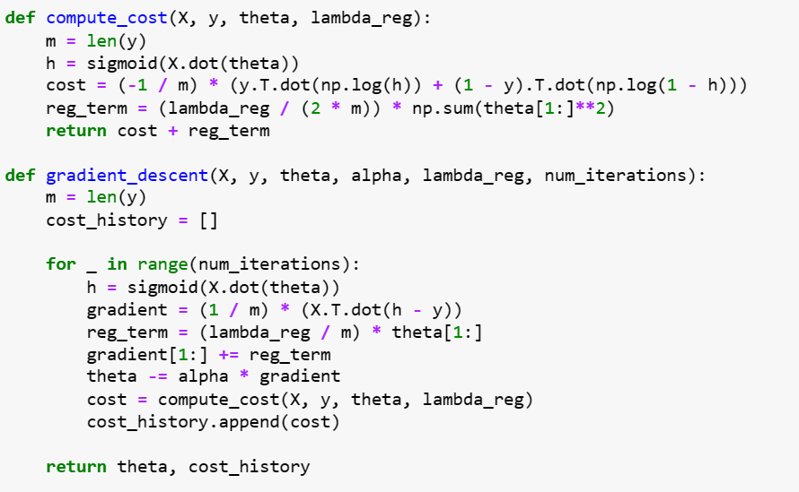
Logistic regression with L2

Slide 18
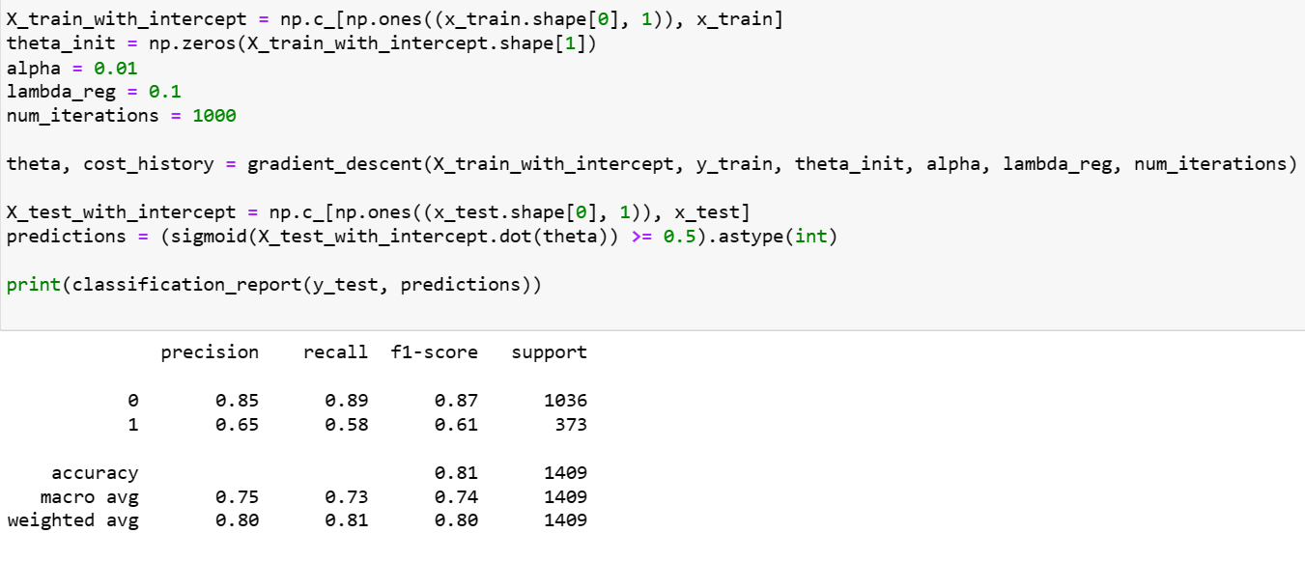
Logistic regression with L2

Slide 19


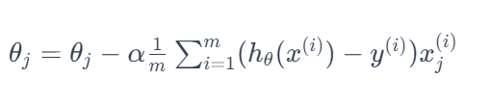
Linear regression
Hypothesis :
Cost function :
Gradient descent :

Slide 20
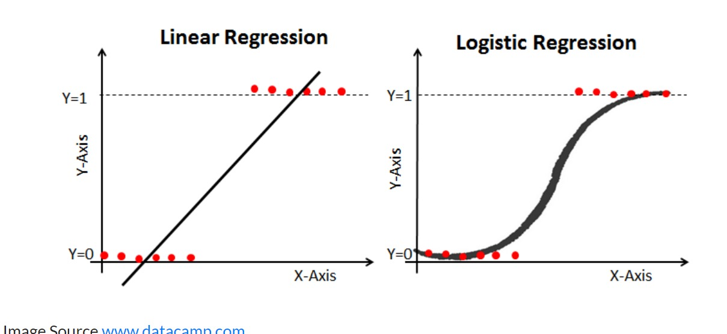
Linear vs Logistic

Slide 21
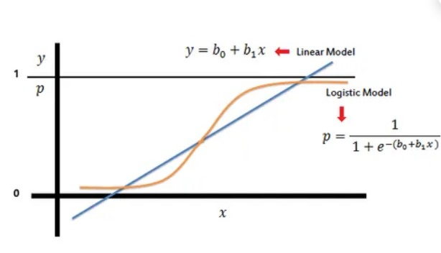
Linear vs Logistic

Slide 22
Linear vs Logistic

Slide 23
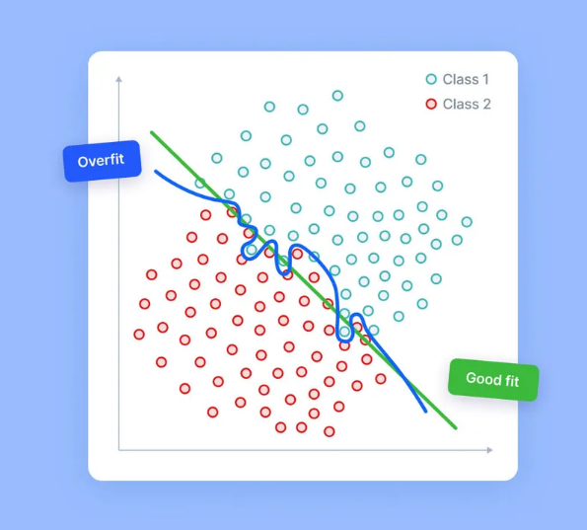
Overfitting

Slide 24
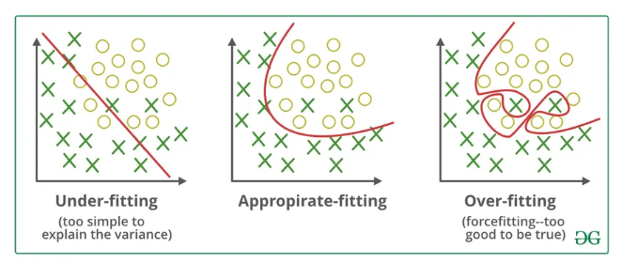

Slide 25
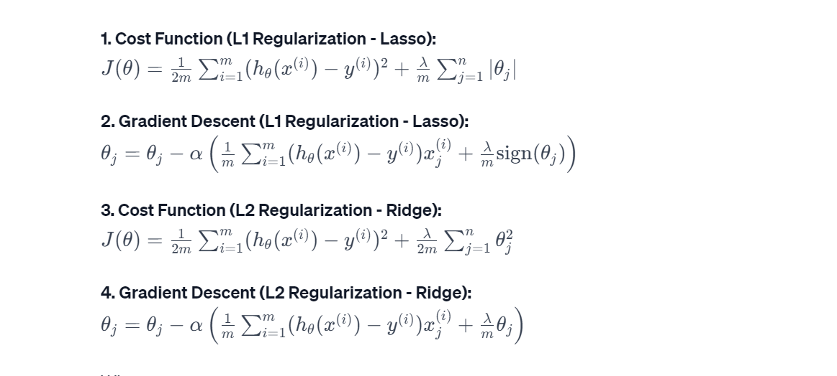
Regularized linear regression

Slide 26
Credit card Fraud Detection
Credit card fraud detection is a crucial task within the financial industry aimed at identifying and preventing fraudulent transactions.
Machine learning, particularly logistic regression, is employed as a predictive modeling technique for this purpose.
Logistic regression, a statistical method, proves to be well-suited for binary classification problems, making it highly applicable for distinguishing between legitimate and fraudulent credit card transactions.
The dataset used for this task typically includes features such as time, transaction amount, and various anonymized numerical features denoted as V1 to V28.
The target variable in this context is binary, indicating whether a transaction is fraudulent (Class = 1) or legitimate (Class = 0).

Slide 27
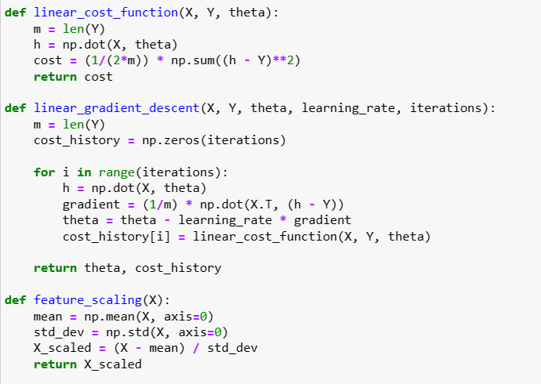
Linear regression

Slide 28
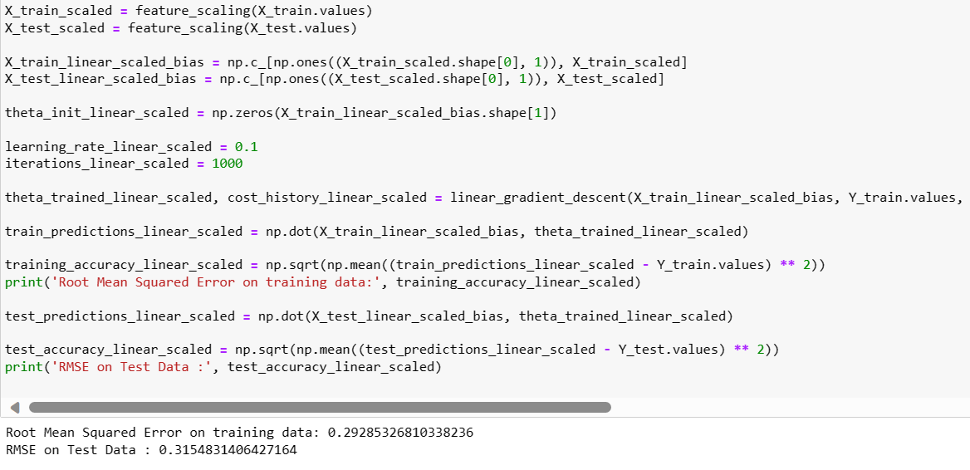
Linear regression

Slide 29
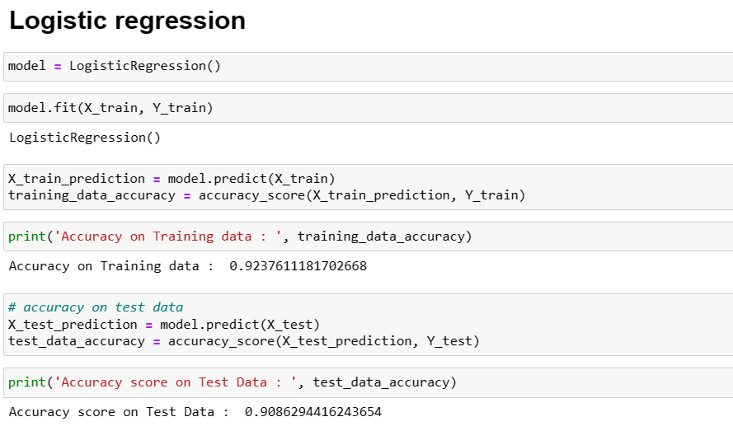
Logistic regression

Slide 30
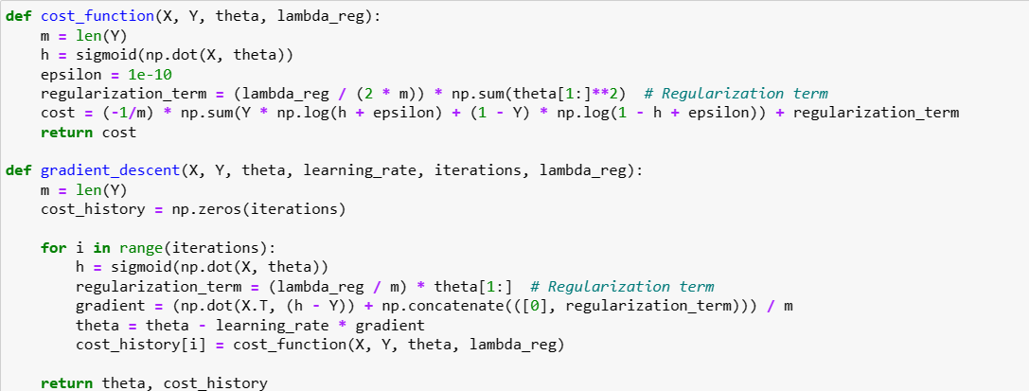
Logistic regression with L1

Slide 31
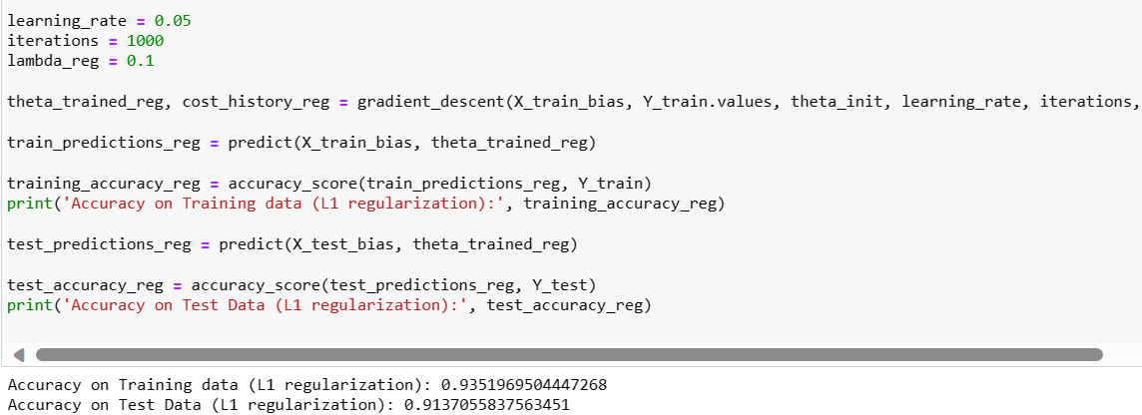
Logistic regression with L1

Slide 32
APPLICATIONS
Cryptocurrency Exchanges: - Detect and prevent fraudulent activities in digital currency transactions.
E-commerce Platforms: - Secure online transactions, build customer trust, and prevent fraudulent activities.
Travel and Hospitality: - Secure financial transactions related to bookings, reservations, and other services.
Healthcare Billing Systems: - Safeguard sensitive financial information in healthcare billing and insurance transactions.
Mobile Payment Apps: - Analyze user behavior and transaction patterns for added security in mobile transactions.

Slide 33
CONCLUSION
Implementing a credit card fraud detection system using machine learning is highly feasible, leveraging abundant historical data and technological advancements. Addressing challenges in data quality, expertise, and compliance is crucial for successful deployment.

Slide 34
Spam Mail Prediction
Logistic Regression in Email Classification:
Logistic regression is a supervised learning algorithm tailored for binary classification problems.
It excels in scenarios like email classification, where the goal is to distinguish between two categories: spam and ham.
Logistic regression models the probability that a given input (email content, in this case) belongs to a certain category.

Slide 35
Methodology
Data Exploration:
The code begins with exploring the dataset, checking for missing values, and providing descriptive statistics.
Data Visualization:
Visualizations are presented to understand the distribution of churn across different categorical features.
Preprocessing:
Unnecessary columns are dropped, and non-numeric columns are encoded. The data is then scaled for uniformity.
Model Training:
The logistic regression model is trained on the preprocessed data. The dataset is split into training and testing sets.
Model Evaluation: Model accuracy is evaluated on both the training and testing sets.

Slide 36
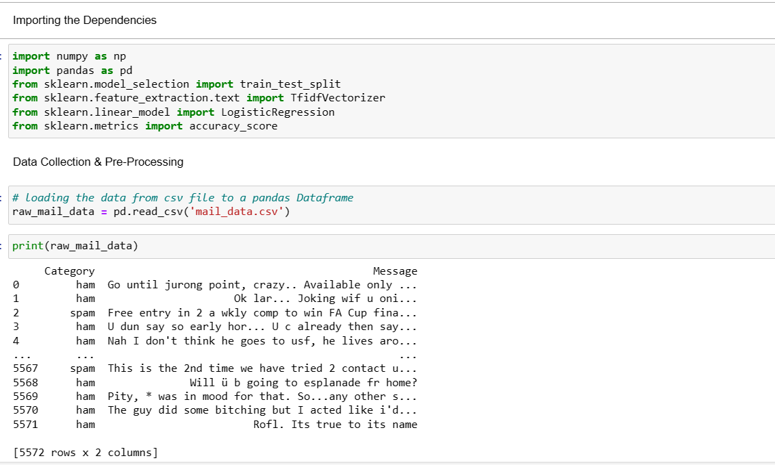
Code

Slide 37
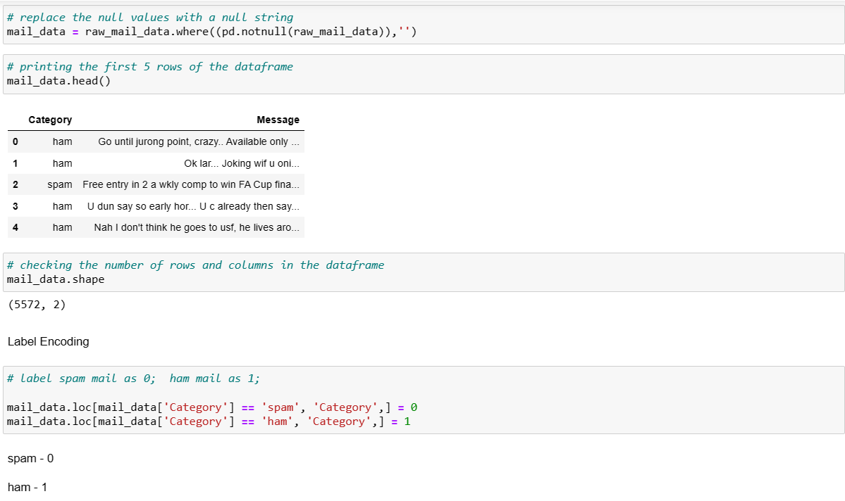
Code

Slide 38
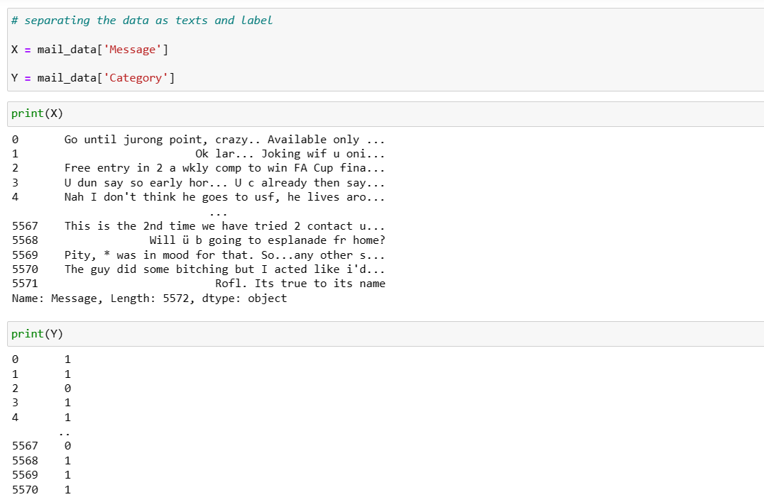
Code

Slide 39
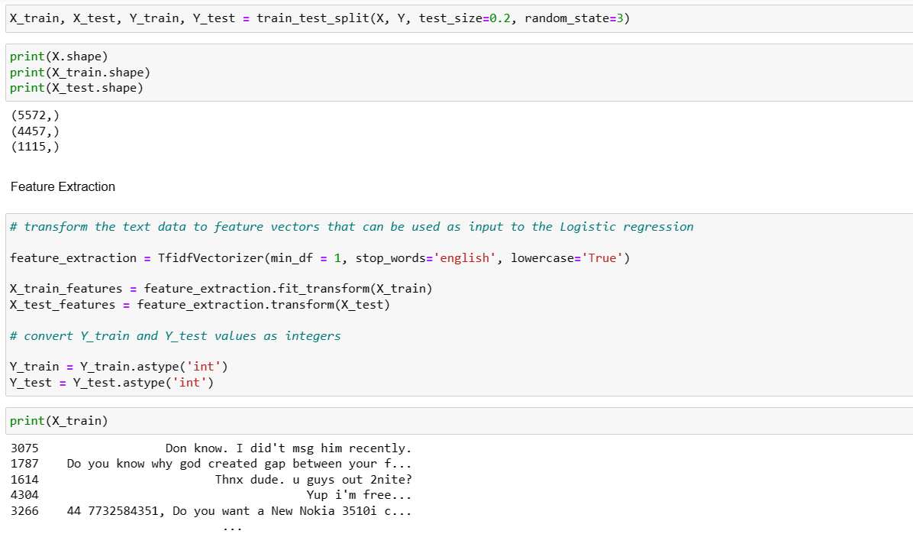
Code

Slide 40
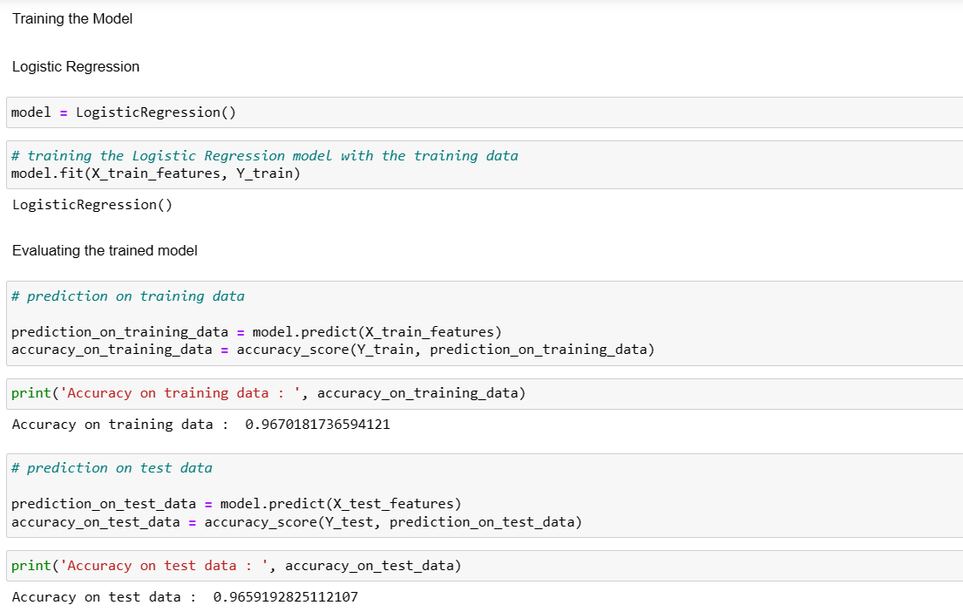
Code

Slide 41
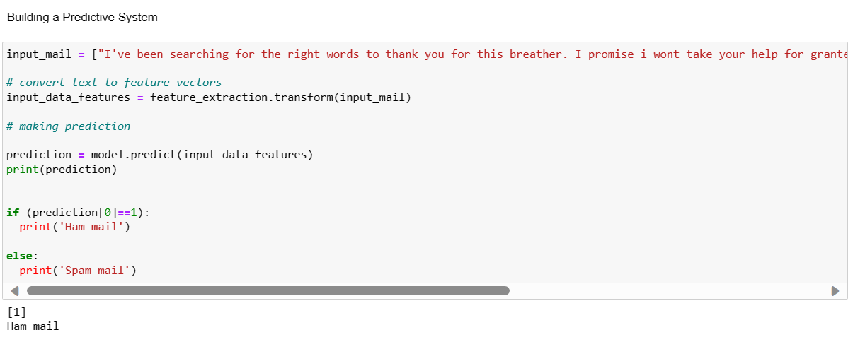
Code

Slide 42
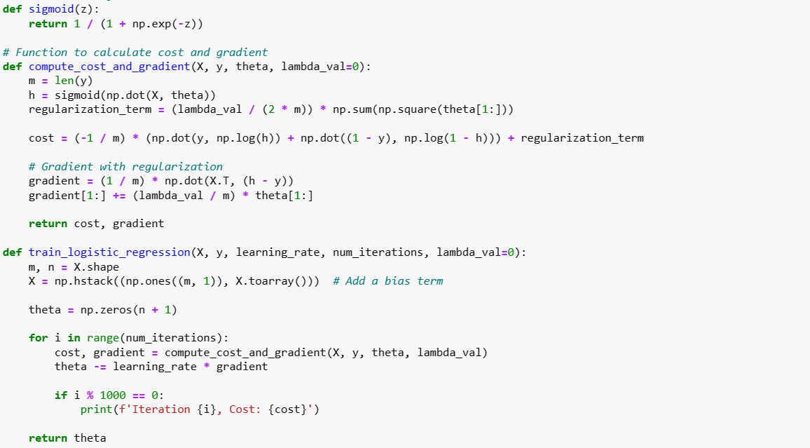
Code

Slide 43
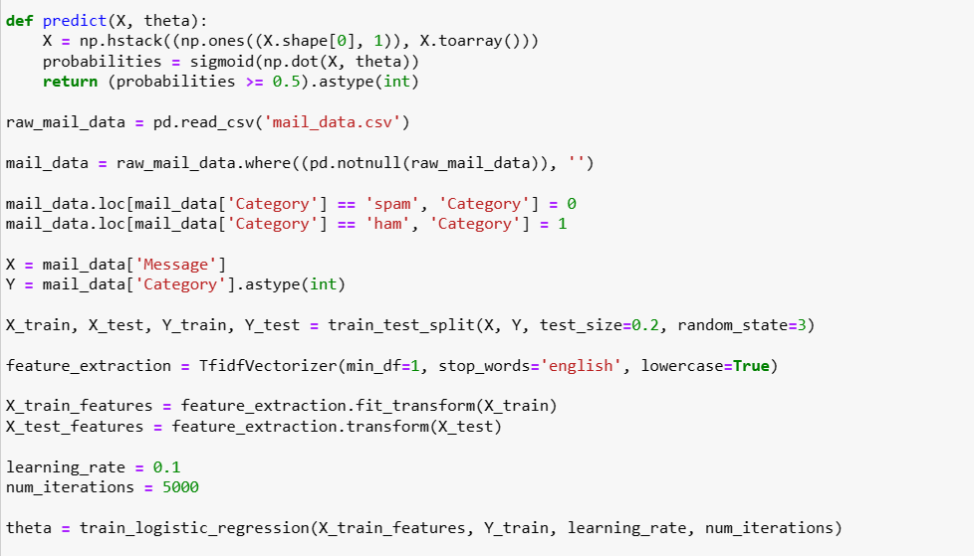
Code

Slide 44
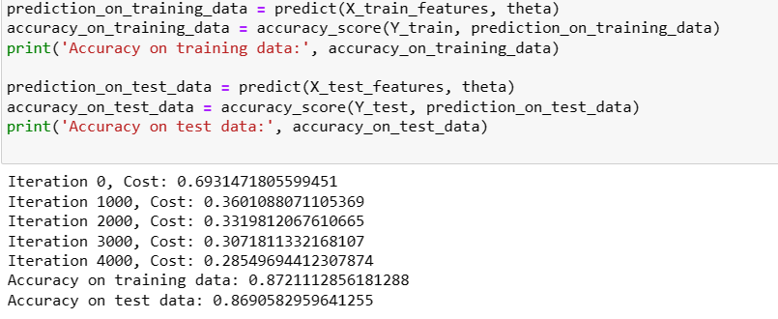
Code

Slide 45
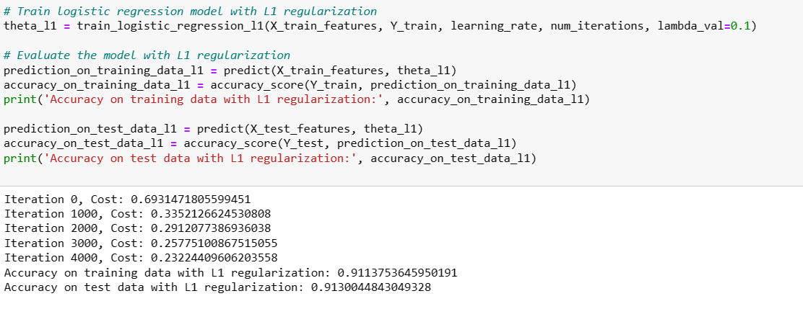
Code

Slide 46
Diabetes prediction
Implementation of logistic regression and logistic regression with L1 regularization for predicting diabetes onset.
Dataset includes features: Pregnancies, Glucose level, BMI, and Age, with 'Outcome' as the target variable (0 for no diabetes, 1 for diabetes).
L1 regularization utilized to prevent overfitting and encourage sparsity, promoting feature selection.
L1 regularization introduces a penalty term to the cost function, driving less important feature coefficients towards zero.
Objective: Predict the likelihood of diabetes based on provided features.
'Outcome' variable indicates the presence (1) or absence (0) of diabetes.
L1 regularization aids in improving model generalization and identifying crucial features for diabetes prediction.

Slide 47
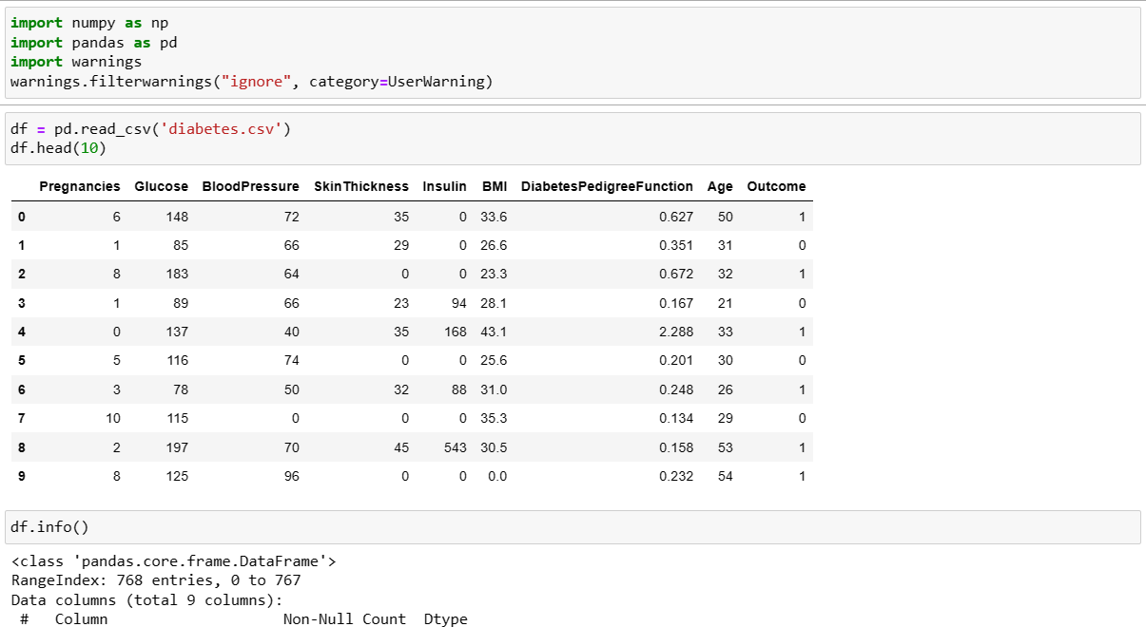
Code

Slide 48
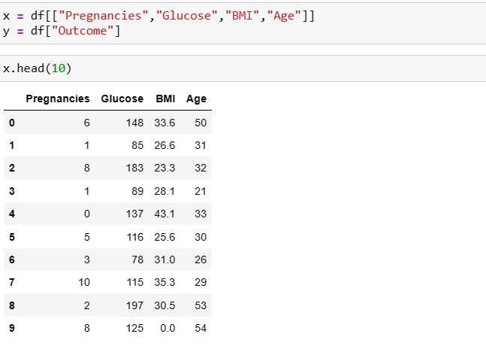
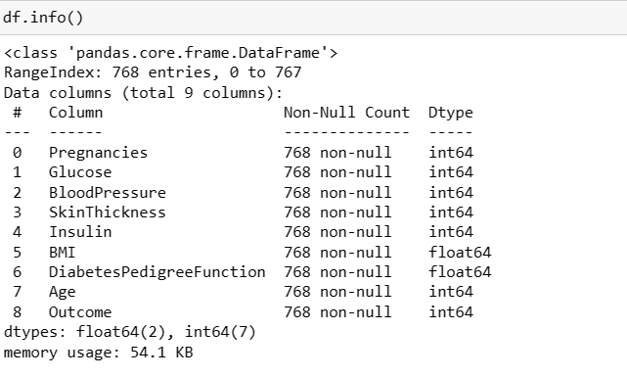
Code

Slide 49
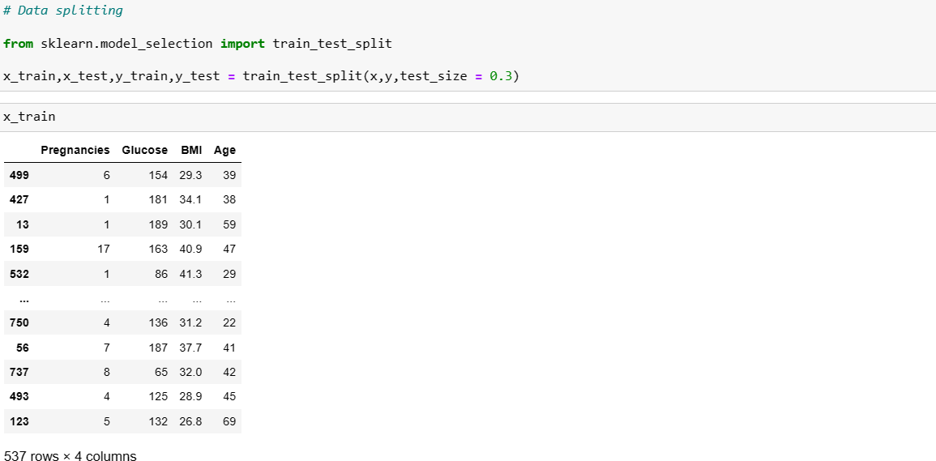
Code

Slide 50
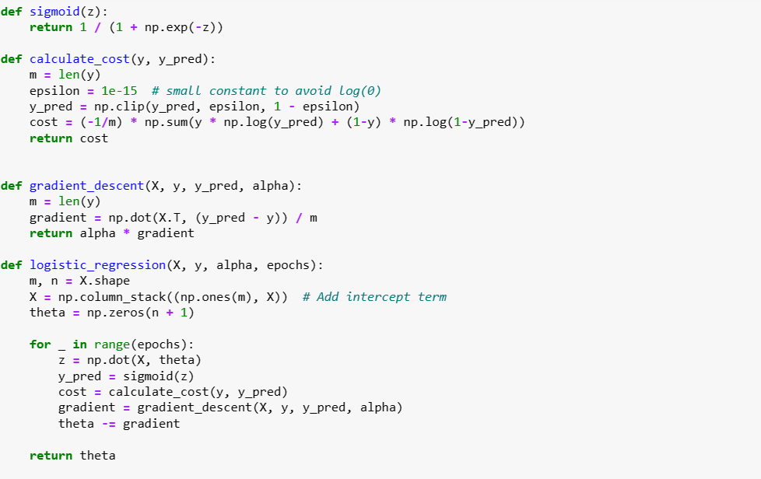
Code - logistic

Slide 51
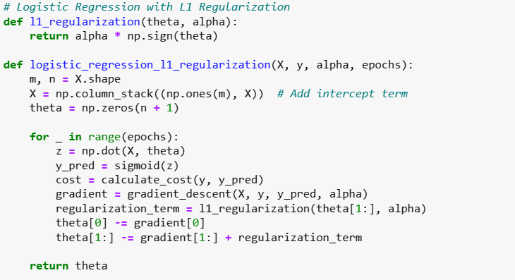
Code

Slide 52
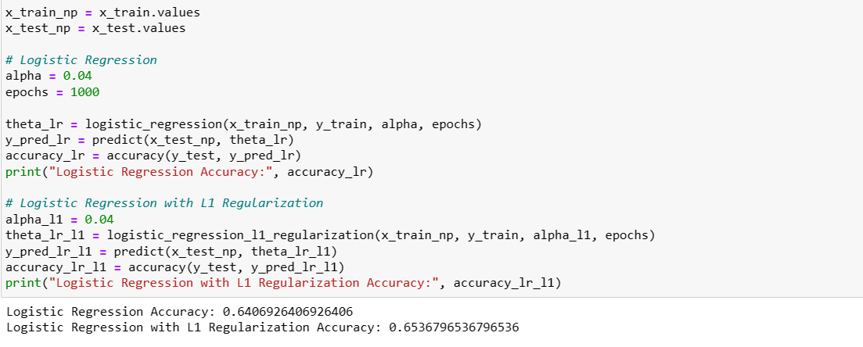
Code

Slide 53
Conclusion
Logistic regression consistently proves versatile for binary classification tasks, making it a reliable choice across diverse applications.
Regularization techniques, such as L1 and L2, play crucial roles in preventing overfitting, improving model interpretability, and aiding in feature selection.
Model effectiveness depends on the specific nature of the dataset and the objectives of each prediction task.
L1 regularization enhances interpretability by driving less important feature coefficients towards zero, aiding in the identification of crucial predictors.
L2 regularization effectively prevents overfitting, particularly valuable when dealing with datasets featuring numerous features or multicollinearity.

Slide 54
Thank You

